Slide 1
Module 2: Mandated Tasks of United Nations Peacekeeping Operations
Lesson
2.2
Peacebuilding Activities

Slide 2
Relevance
Peacekeeping personnel are “early peacebuilders”:
Peacekeeping is temporary
Peacebuilding helps lasting peace
UN Core Pre-Deployment Training Materials 2017

Slide 3
Learning Outcomes
Learners will:
List examples of mandated tasks which are peacebuilding activities
Describe peacebuilding activities
Identify different roles of mission components in peacebuilding activities
UN Core Pre-Deployment Training Materials 2017

Slide 4
Lesson Overview
Overview of Peacebuilding Activities
Mine Action
Disarmament, Demobilization & Reintegration of Ex-Combatants
Security Sector Reform
Rule of Law-Related Activities
Electoral Assistance
Support to the Restoration & Extension of State Authority
UN Core Pre-Deployment Training Materials 2017

Slide 5
Learning Activity
2.2.1
Film: Rule of Law, Peace and Security
Instructions:
What does it mean to be “safe” and “secure”?
How does the state contribute?
How can the mission support the state?
Time: 15 minutes
Film: 6:48 minutes
Discussion: 5-7 minutes
https://www.youtube.com/watch?v=LSWR_WXDMhU
UN Core Pre-Deployment Training Materials 2017

Slide 6
1. Overview of Peacebuilding Activities
Mine Action
Disarmament, Demobilization and Reintegration (DDR)
Security Sector Reform (SSR)
Rule of Law (ROL)-related activities
Electoral assistance
Support to the restoration and extension of State authority
UN Core Pre-Deployment Training Materials 2017

Slide 7
Learning Activity
2.2.2
Importance of Peacebuilding Activities
Instructions:
Consider the testimonies of civilians
Discuss impact of the challenges on civilians
What is needed to improve lives?
Time: 15 minutes
Group work: 5-7 minutes
Discussion: 5-7 minutes
UN Core Pre-Deployment Training Materials 2017

Slide 8
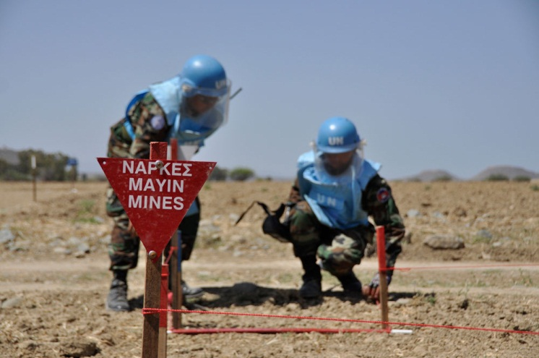
2. Mine Action
To reduce the threat and impact of landmines, explosive remnants of war, other explosive hazards
Five pillars:
Clearance
Risk education
Victim assistance
Stockpile destruction
Advocacy
UN Core Pre-Deployment Training Materials 2017

Slide 9
2. Mine Action
United Nations Mine Action Service (UNMAS)
UNPKO integrates mine action, UNMAS leads
UN Core Pre-Deployment Training Materials 2017

Slide 10
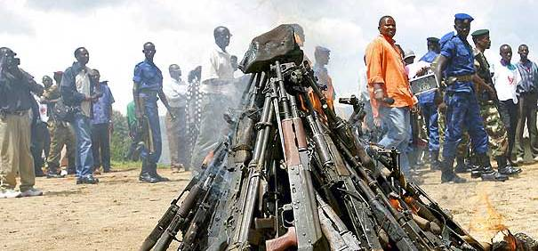
3. Disarmament, Demobilization & Reintegration (DDR)
Disarmament: collection, documentation, control, disposal of weapons
Demobilization: discharge of active combatants from armed forces or groups
Reinsertion*: transitional assistance covering basic needs
Reintegration: process to acquire civilian status, sustainable employment, income
UN Core Pre-Deployment Training Materials 2017

Slide 11
3. Disarmament, Demobilization & Reintegration (DDR)
UNPKO:
Contributes to UN system efforts
Enables national DDR programmes
Provides technical advice
Secures disarmament and cantonment sites
Collects and destroys weapons
UN Core Pre-Deployment Training Materials 2017

Slide 12
4. Security Sector Reform (SSR)
State
National Security and Justice Sector
Police
Border Security
Prisons
Non-State Security Providers
Defence
Civil Society
Parliament/Ministries
Judiciary
Security and Justice Needs
PEOPLE
UN Core Pre-Deployment Training Materials 2017
Notes:
Possibly replacing this diagram?

Slide 13
4. Security Sector Reform (SSR)
UNPKO:
Facilitates national SSR dialogues
Develops national security policies, strategies, plans
Strengthens oversight, management, coordination
Prepares legislation
Mobilizes resources, harmonize support
Education, training, institution building
Monitors and evaluates
Defence sector reform
UN Core Pre-Deployment Training Materials 2017

Slide 14
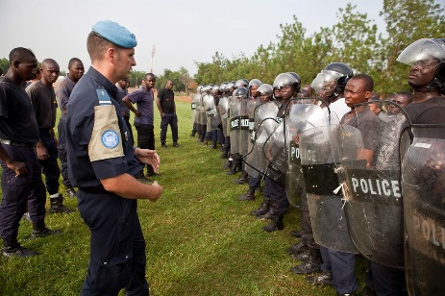
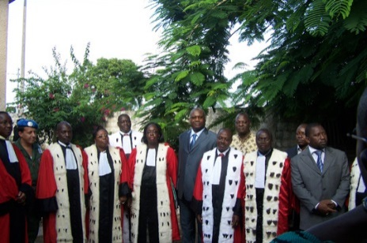
5. Rule of Law (ROL)-Related Activities
ROL: legal and political framework under which all persons and institutions, including state, are accountable
Laws are:
Publicly promulgated
Equally enforced
Independently adjudicated
Consistent with IHRL
UN Core Pre-Deployment Training Materials 2017

Slide 15
5. Rule of Law (ROL)-Related Activities
UNPKO:
Comprehensive plans include building police stations, court houses, prisons
Develops local capacity, human resources
Oversees rehabilitation of training centres, universities
UN Core Pre-Deployment Training Materials 2017

Slide 16
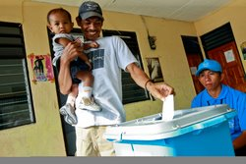
6. Electoral Assistance
Legal, technical, logistic support to electoral laws, processes and institutions
Technical assistance
Election observation, other assessments
Organization or supervision of elections
UN Core Pre-Deployment Training Materials 2017

Slide 17
6. Electoral Assistance
Department of Political Affairs’ (DPA) Electoral Assistance Division
UNPKO collaborates with DPA and UNCT
UN Core Pre-Deployment Training Materials 2017

Slide 18
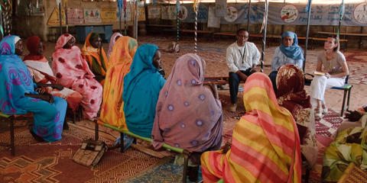
7. Support to the Restoration & Extension of State Authority
Rebuilding legitimacy and people’s confidence in state institutions
UN Core Pre-Deployment Training Materials 2017

Slide 19
7. Support to the Restoration & Extension of State Authority
UNPKO:
Key role of Civil Affairs Officers
Develop accountability, transparency
Preliminary assessments of needs
Monitor delivery of public services
Local civic education, sensitization
Logistical, administrative support
Capacity-building of local people
Support to policy, planning, decision-making
Mobilization of donor interest
UN Core Pre-Deployment Training Materials 2017

Slide 20
Summary of Key Messages
Peacebuilding activities – mine action, DDR, SSR, ROL, electoral assistance, support to extension/restoration of State authority
Peacebuilding activities – create conditions for lasting peace
Different roles of mission components – lead, support
UN Core Pre-Deployment Training Materials 2017

Slide 21
Questions
UN Core Pre-Deployment Training Materials 2017

Slide 22
Learning Activity
Learning Evaluation
UN Core Pre-Deployment Training Materials 2017

